Slide 1

Road Object Detection in Fish-Eye Cameras
NCKU Acvlab
RE6124027 數據所 曾文海
RE6124019 數據所 吳明軒

Slide 2

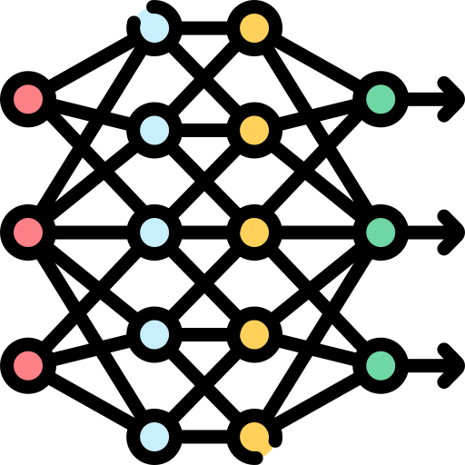
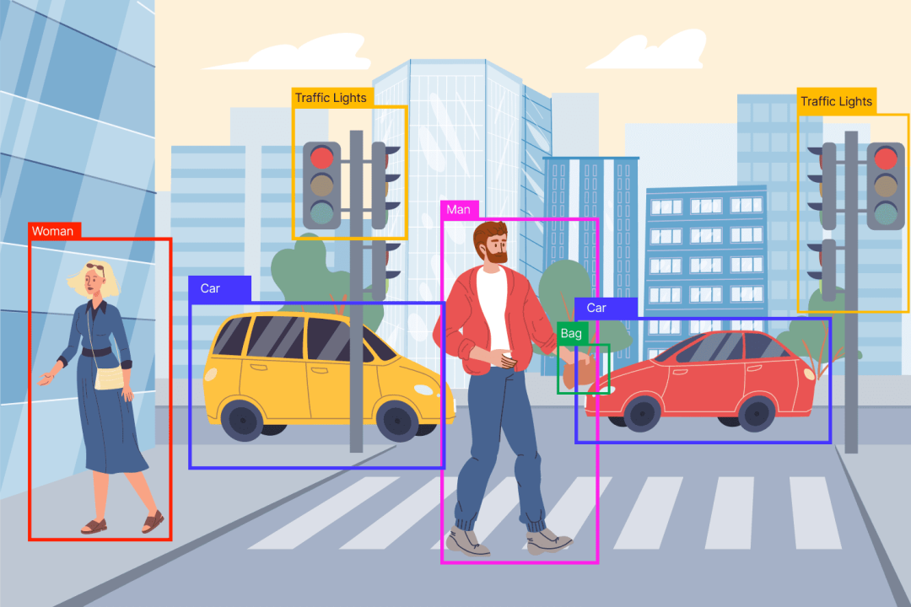
background
Deep Learning
Self-driving
Object detection
parameter
神經網路模型
道路監控 與 自動駕駛技術
Confidence threshold、IoU

Slide 3
Motivation
原因：
最近參加CVPR AICity的魚眼相機道路物件辨識的競賽
問題：
魚眼圖像物件辨識： 魚眼圖像由於相機的特行，拍攝出來的照片會畸變，導致變形或使物件變小難以辨識。
單一信心度閥值(參數固定)： 可能無法適應不同情境(白天、黑夜)、類別(汽車、機車、人)和物件大小的物件辨識分類

Slide 4
Targets
魚眼圖像物件辨識
模型學習信心參數
我們預期使用一些技巧完成魚眼物件辨識
預處理 對魚眼圖片進行轉換
使用合適的物件辨識模型 YOLO、ViT等等
後處理 使用TTA方式讓物件更容易被辨識
達成高效能魚眼圖像物件辨識
我們希望將傳統手動設定固定參數做處理，讓模型能夠學習這些參數。
達成不同情境、不同類別和不同大小的信心度參數自動化。

Slide 5
Methods
魚眼圖像物件辨識
模型學習信心參數
預處理： 旋轉、魚眼轉換等對訓練圖片增強
模型使用： YOLOv9、Co-DETR
後處理： 對測試圖片增強，重複辨識
多尺度特徵提取(不同大小)：
不同尺度下提取特徵。
依特徵重要性計算信心度。
上下文感知模塊(不同情境)：
引入上下文信息，如周圍物件的分佈、場景結構等。
融合策略(不同類別)：
設計有效的融合策略，將不同信息源的置信度信息整合到最終的偵測結果中。

Slide 6
RESULT
本研究預期可以提出一種新型的多置信度物件偵測模型，該模型在偵測結果的置信度評估方面能夠顯著優於傳統的單一置信度模型。這將有助於提高物件偵測系統的準確性和可靠性，並且能夠應用於各種對偵測結果信心度要求較高的應用場景中，例如自動駕駛、監控系統等。

Slide 7
KOREAN SIMPLE STYLE CONSULTING
toolkit
Here is where your presentation begins

Slide 8
CONTENTS OF THIS TEMPLATE
T
0
Here’s what you’ll find in this Slidesgo template:
A slide structure based on a consulting sales pitch presentation, which you can easily adapt to your needs. For more info on how to edit the template, please visit Slidesgo School or read our FAQs.
To view this template with the correct fonts in ppt format, download and install on your computer the fonts that we have used. You can learn how to download and install fonts here.
An assortment of graphic resources that are suitable for use in the presentation can be found in the alternative resources slide.
A thanks slide, which you must keep so that proper credits for our design are given.
A resources slide, where you’ll find links to all the elements used in the template.
Instructions for use.
Final slides with:
The fonts and colors used in the template.
A selection of illustrations. You can also customize and animate them as you wish with the online editor. Visit Storyset to find more.
More infographic resources, whose size and color can be edited.
Sets of customizable icons of the following themes: general, business, avatar, creative process, education, help & support, medical, nature, performing arts, SEO & marketing, and teamwork.
You can delete this slide when you’re done editing the presentation.
toolkit

Slide 9
—SOMEONE FAMOUS
T
0
“This is a quote, words full of wisdom that someone important said and can make the reader get inspired.”
toolkit

Slide 10

01
Proyect & strategy
02
Consulting proposal
03
Change management
04
Implement changes
T
0
You can describe the topic of the section here
You can describe the topic of the section here
You can describe the topic of the section here
toolkit
You can describe the topic of the section here

Slide 11
01
PROJECT & STRATEGY
T
1
toolkit
You can enter a subtitle here if you need it

Slide 12
PROJECT & STRATEGY DEFINITION
T
1
You can give a brief description of the topic you want to talk about here. For example, if you want to talk about Mercury, you can say that it’s the smallest planet in the entire Solar System
toolkit

Slide 13
Strategic planning project plan
T
1
STEP | week | 1 | 2 | 3 | 4 | 5 | 6 | 7 | 8 | 9 | 10 | 11 | 12
1-Kick off
2-Business insights
3-Mission and vision
4-Key Strategic Objectives
5-Strategic map
6-Balance scorecard
7-Strategic objectives
8-First report
Workshop # 1
toolkit
Workshop # 2

Slide 14
Strategic planning of goals
T
1
Steps |  | Week 1 | Week 2 | Week 3 | Week 4 | Week 5 | Week 6
1 | Kick-off
2 | Business insights
3 | Mission and vision
4 | Key strategic objectives
5 | Strategic map
6 | Balanced scorecard
7 | Strategic objectives
8 | First report
Mercury is the smallest planet
Venus has high temperatures
Neptune is cold
Mars is full of iron
Jupiter is the biggest planet
toolkit
Saturn is the planet with rings
Earth is where we all live
Venus is a hot planet

Slide 15
Annual profitable growth
T
1
Phase 1
Phase 2
Phase 3
Phase 4
toolkit
Plan
Adapt
Test
Report
Mercury is the smallest planet
Despite being red, Mars is cold
Venus has a beautiful name
Jupiter is the biggest planet

Slide 16
Strategic planning project plan
Mission
Vision
Objectives
Key Initiatives
T
1
Venus is the second planet from the Sun and it is very hot
Jupiter is the biggest planet in the
Solar System and a gas giant
toolkit
Despite being red, Mars is a very cold planet
Saturn is composed mostly of hydrogen and helium

Slide 17
Strategy map & balanced scorecard
T
1
PERSPECTIVES
FINANCIAL | F1- Insert your own text | F2- Insert your own text
CUSTOMER | C1- Insert your own text | F2- Insert your own text
INTERNAL PROCESS | >I1- Insert your own text | F2- Insert your own text
LEARNING & GROWTH | L1- Insert your own text | F2- Insert your own text
STRATEGIC OBJECTIVES
toolkit

Slide 18
Strategy map & balanced scorecard ii
T
1
FINANCIAL PROJECTS
Mercury is the smallest
CUSTOMER SERVICES
Venus is a hot planet
PERSPECTIVE
OBJECTIVES
INTERNAL PROCESS
Mars is a cold place
toolkit
LEARNING & GROWTH
Only the Earth has life

Slide 19
Balanced scorecard
Financial projects
Customer services
Internal process
Learning & growth
T
1
Venus is the second planet from the Sun
It’s the biggest planet in the Solar System
toolkit
Despite being red, Mars is a cold planet
Saturn is a gas giant and has several rings

Slide 20
Strategic options: risks
T
1
MARKET DEVELOPMENT STRATEGY
DIVERSIFICATION STRATEGY
New
Use a different color for the strategic option you recommend the company to choose
MARKET
MARKET PENETRATION STRATEGY
PRODUCT DEVELOPMENT STRATEGY
Current
toolkit
Current
New
PRODUCTS

Slide 21

Impact of the risks
5%
45%
Saturn
Venus
20%
30%
Jupiter
Mars
T
1
Saturn is a gas giant and has several rings
Venus is the second planet from the Sun
toolkit
It’s the biggest planet in the Solar System
Despite being red, Mars is cold
Follow the link in the graph to modify its data and then paste the new one here. For more info, click here

Slide 22
Corporate strategies
Mars
Venus
Mercury
T
1
Despite being red, Mars is actually a cold place. It’s full of iron oxide dust
Venus has a beautiful name and is the second planet from the Sun
It’s the closest planet to the Sun and the smallest in the Solar System
toolkit

Slide 23
Key drivers of the profit
T
1
 | DESCRIPTION | EXAMPLE
THE SITUATION | You need to provide a neutral description | Our company has been selling its products in the US
THE COMPLICATION | It’s a desired change of the current situation | With a market share already above 40%
THE QUESTION | It’s a result coming from the current situation | Should we enter the European market?
toolkit

Slide 24
Decisions: market, product, company
T
1
What will be the profitability?
What is the potential demand for our product?
What is the feasibility to enter this new market?
toolkit
Sweet spot

Slide 25
Strategic perspectives
Venus
Jupiter
Mars
Saturn
T
1
Venus is the second planet from the Sun and it is very hot
Jupiter is the biggest planet in the
Solar System and a gas giant
toolkit
Despite being red, Mars is a very cold place
Saturn is composed mostly of hydrogen and helium

Slide 26

A PICTURE ALWAYS REINFORCES
THE CONCEPT
T
1
Images reveal large amounts of data, so remember: use an image instead of a long text. Your audience will appreciate it
toolkit

Slide 27
Awesome words
T
1
toolkit

Slide 28
Strong business plan
Political
Economical
Social
Technological
Legal
Environmental
T
1
P
E
S
T
L
E
Replace the text with your own text
Replace the text with your own text
Replace the text with your own text
Replace the text with your own text
toolkit
Replace the text with your own text
Replace the text with your own text

Slide 29
Strong business plan ii
T
1
Political
Social
Legal
Venus is the second planet from the Sun
Despite being red, Mars is a cold planet
Mercury is the closest planet to the Sun
P
E
S
T
L
E
toolkit
Economical
Technological
Environmental
Jupiter is the biggest planet of them all
Saturn is composed of hydrogen and helium
Neptune is the farthest planet from the Sun

Slide 30
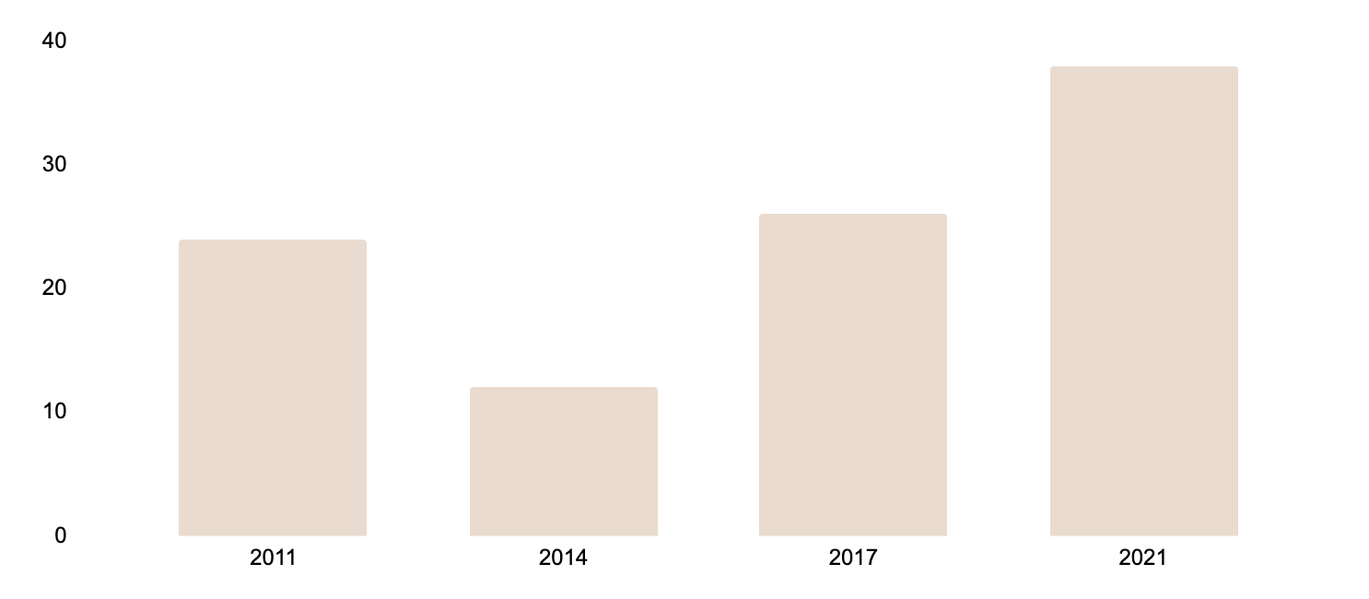
Strong business case
$4M
PROJECT COST
$14M
TANGIBLE BENEFITS
$8M
NET PRESENT VALUE
CASH FLOW (€ millions )
CHANGE IMPACT
Low
Medium
High
Project manager name
MANAGER
SPONSOR
Sponsor Name
$24M
$12M
$26M
$38M
Follow the link in the graph to modify its data and then paste the new one here. For more info, click here

Slide 31
Financial model
T
1
HISTORICAL RESULTS
FORECAST PERIOD
ICM Model
2014
2015
2016
2017
2018
2019
2020
2020
BALANCE SHEET
ASSET
Cash
xx
xx
xx
xx
xx
xx
xx
xx
Accounts
xx
xx
xx
xx
xx
xx
xx
xx
Inventory
xx
xx
xx
xx
xx
xx
xx
xx
toolkit
Current assets
xx
xx
xx
xx
xx
xx
xx
xx
Property
xx
xx
xx
xx
xx
xx
xx
xx
Goodwill
xx
xx
xx
xx
xx
xx
xx
xx
Total
xx
xx
xx
xx
xx
xx
xx
xx

Slide 32
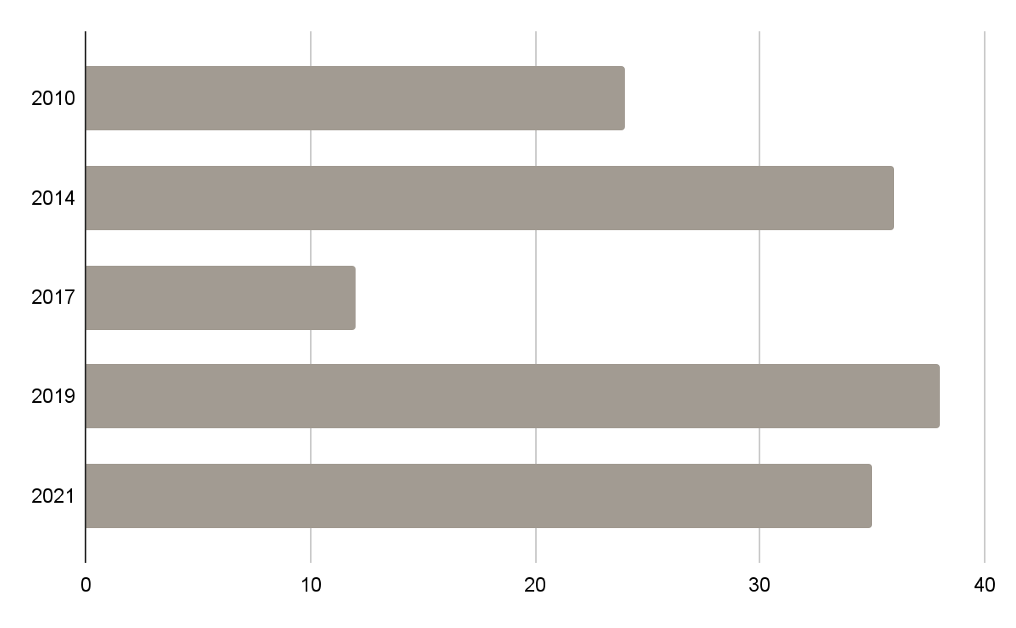
Financial model
T
1
60%
40%
toolkit
Jupiter
Mars
Mars
Jupiter is the biggest planet
Despite being red, Mars is cold place
Follow the link in the graph to modify its data and then paste the new one here. For more info, click here

Slide 33
Pricing strategy
T
1
ADVANCED
STANDARD
BASIC
20%
70%
10%
Venus is the second planet from the Sun
Jupiter is the biggest planet of them all
Saturn is a gas giant and has several rings
toolkit

Slide 34
Pricing strategy II
T
1
Leading
Standard
Advanced
Basic
LEVEL | 1 | 2 | 3 | 4
PERCENTAGE | 20% | 70% | 8% | 2%
DESCRIPTION | Insert your description here Insert your description here | Insert your description here Insert your description here | Insert your description here Insert your description here | Insert your description here Insert your description here
toolkit

Slide 35
02
CONSULTING PROPOSAL
T
2
toolkit
You can enter a subtitle here if you need it

Slide 36
Consulting proposal
Services
Fees
Invoices
Expenses
Materials
Terms
T
2
Mercury is the closest planet to the Sun
Venus is the second planet from the Sun
Mars is actually a very cold place
toolkit
Jupiter is the biggest planet of them all
Saturn is composed of hydrogen and helium
Neptune is the farthest planet of them all

Slide 37

T
2
A PICTURE IS WORTH A THOUSAND WORDS

Slide 38
Answers and supporting arguments
Select non-core functions
Compare to
Best benchmarks
Evaluate cost of
suppliers
T
2
How can the company reduce its cost by 10%?
Reduce costs by $5 million through
operational improvements
Outsource non-core
functions to save $3 million
Evaluate cost and service level
One partner foreach function
Simplify core function processes to save $1 million
Design current processes
Adopt best practices
toolkit
Review supplier cost to save
$1 million
Review current supplier costs
Negotiate supplier contracts

Slide 39
Answers and supporting arguments II
T
2
How can the company reduce costs by 10%
Reduce costs by $5 million through
operational improvements
Outsource non-core
functions to save $3 million
Simplify core functions processes to save $1 million
Review supplier cost to save $1 million
Evaluate cost and service
level of potential partners
Design current processes
Select and review current
supplier costs
toolkit
Select non-core functions
Compare current process to best-in-class benchmarks
Evaluate cost of potential
alternative suppliers
Choose one partner for
each function
Adopt best practices based on benchmarks
Negotiate supplier
contracts/choose options

Slide 40
Prioritization matrix: impact & effort
Impact
Effort
T
2
An initiative with a high impact would mean one of the following:
-The initiative needs to happen in order to achieve the desired future state
-The initiative will significantly reduce our cost or increase our revenue
The “effort” criteria is assessed based on the following:
- Ease of implementation
- Time frame required
- Resources required (Number of people, capital investment, etc.)
toolkit

Slide 41
Prioritization matrix
T
2
 | INITIATIVE | IMPACT | EFFORT
1 | List all your potential initiatives |  | Very high
2 | List all your potential initiatives |  | High
3 | List all your potential initiatives |  | Low
4 | List all your potential initiatives |  | Low
5 | List all your potential initiatives |  | High
6 | List all your potential initiatives |  | Very high
toolkit

Slide 42
03
CHANGE MANAGEMENT
T
3
toolkit
You can enter a subtitle here if you need it

Slide 43

Ansoff growth matrix
T
3
Do you know what helps you make your point clear?
Lists like this one:
- They’re simple
- You can organize your ideas clearly
- You’ll never forget to buy milk!
And the most important thing: the audience won’t
miss the point of your presentation
toolkit

Slide 44
Business case
1
4
2
5
3
6
T
3
Mercury is the closest planet to the Sun
BUSINESS NAME
Jupiter is the biggest planet of them all
COMPANY LOGO HERE
Venus is the second planet from the Sun
Saturn is composed of hydrogen and helium
toolkit
Mars is actually a very cold place
XX/XX/XX
Neptune is the farthest planet from the Sun

Slide 45
Business case ii
T
3
Mercury is the smallest planet
1
Business name
4
Saturn is composed of hydrogen
Jupiter is the biggest planet
2
5
Mars is actually a very cold place
toolkit
Venus has very high temperatures
3
6
Neptune is very far from the Sun
xx/xx/xxxx

Slide 46
Competitor comparison table
T
3
ATTRIBUTES | COMPETITOR A | COMPETITOR B | MY BUSINESS
PRICE | $360 | $320 | $300
QUALITY | Low | Medium | High
CUSTOMER AGE | 20-40 | 18-45 | 18-50
REPUTATION | Bad | Average | Good
LOCATION | Spain | Italy | EEUU
toolkit

Slide 47

Target
T
3
Suzanne Wilson
NAME
45 years
AGE
Lawyer-5 years experience
OCCUPATION
80%
YOGA
Spanish
English
60%
FOOTING
Italian
French
70%
READ
Venus has a beautiful name and is the second planet from the Sun. It’s terribly hot, and its atmosphere is extremely poisonous. It’s the second-brightest natural object in the night sky.
toolkit
100%
90%
70%
50%

Slide 48
Implement, track & manage progress
T
3
MANAGE PROGRESS
 | PROGRESS | STATUS | LINK
VENUS | 65% |  | www.yourlink.com
JUPITER | 60% |  | www.yourlink.com
MARS | 75% |  | www.yourlink.com
NEPTUNE | 40% |  | www.yourlink.com
EARTH | 90% |  | www.yourlink.com
CERES | 70% |  | www.yourlink.com
toolkit

Slide 49
Change management strategy & plan
 | CHANGE | SIZE | COMPLEXITY
1 | Name of change | Extreme | 1 team impacted
2 | Name of change | Extreme | 1 business unit
3 | Name of change | High | 1 division
4 | Name of change | Medium | Half company
5 | Name of change | High | Extreme
6 | Name of change | Moderate | Half company
SIZE:
Extreme
High
Medium
Moderate
Low
COMPLEXITY:
Team
Business
Division
Company
Extreme

Slide 50
Change management strategy & plan ii
T
3
size of the change
EXTREME | Name of the change | Name of the change | Name of the change
HIGH |  |  | Name of the change | Name of the change | Name of the change
MEDIUM |  |  |  | Name of the change
MODERATE | Name of the change
LOW
 | 1 team impacted | 1 business unit | 1 division | Half company | extreme
complexity of the change
toolkit

Slide 51
IMPLEMENTING CHANGES
04
T
4
toolkit
You can enter a subtitle here if you need it

Slide 52
Sales and strategy plan
T
4
1
2
3
Implementation
Internal analysis
External analysis
5
4
toolkit
Sales plan
Sales strategy

Slide 53
500,000
T
4
toolkit
Big numbers catch your audience’s attention

Slide 54
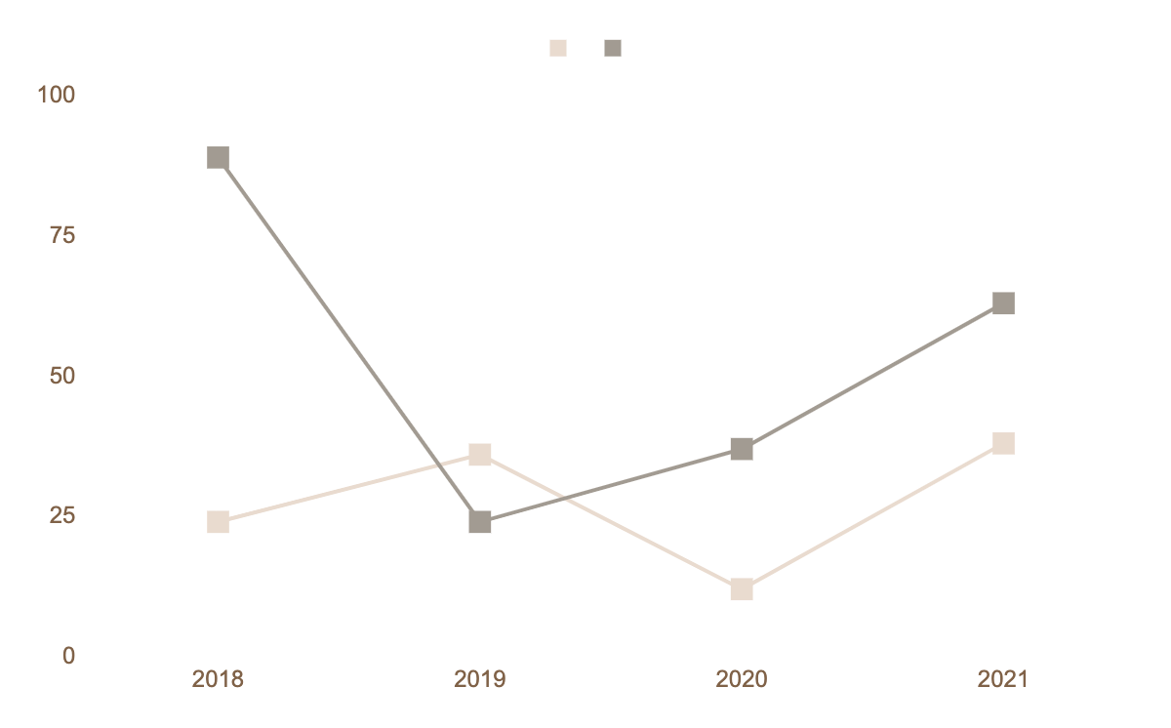
About the terms of the agreement
T
4
Mars
Mars is actually a very cold place
Mercury
It's the closest planet to the Sun
toolkit
Follow the link in the graph to modify its data and then paste the new one here. For more info, click here

Slide 55

$20,000
$15,000
$45,000
T
4
Mars is actually a cold place
Venus has a beautiful name
toolkit
Saturn has several rings

Slide 56
Management approach
T
4
Mercury is the smallest planet
Venus is the second planet from the Sun
January
February
March
April
toolkit
Mars is actually a very cold place
The Earth is the planet we live

Slide 57
Strategic alliances
T
4
MERCURY
It’s the closest planet to the Sun
toolkit
MARS
Mars is actually a very cold place

Slide 58
Answers and arguments
T
4
WRITE YOUR QUESTION
WRITE YOU ANSWER
MERCURY
VENUS
JUPITER
toolkit
Mercury is the closest planet to the Sun
Venus is the second planet from the Sun
Jupiter is the biggest planet of them all

Slide 59
Waterfall management plan
T
4
REQUIREMENTS
Mercury is the closest planet to the Sun
DESIGN
Venus is the second planet from the Sun
IMPLEMENTATION
The Earth is the third planet from the Sun
VERIFICATION
Mars is actually a very cold place
toolkit
MAINTENANCE
Jupiter is the biggest planet of them all

Slide 60
Waterfall management plan ii
T
4
REQUIREMENTS
Saturn is the only planet with rings
Mercury the closest planet to the Sun
DESIGN
IMPLEMENTATION
Neptune is the farthest planet from the Sun
toolkit
Mars is a surprisingly cold place
VERIFICATION
MAINTENANCE
Venus has very high temperatures

Slide 61
Maturity model
Basic
Standard
Advanced
30%
50%
70%
T
4
Mercury is the closest planet to the Sun
Venus is the second planet from the Sun
The Earth is the third planet from the Sun
toolkit

Slide 62
Profitability ratios
T
4
WORST
PEER
BEST
RETURN ON SALES (%)
%
%
%
RETURN ON EQUITY (%)
%
RETURN ON NET ASSETS (%)
%
%
RETURN CAPITAL EMPLOYED (%)
%
toolkit
RETURN ON FUNDS EMPLOYED (%)
%
%
VENUS
MARS
JUPITER

Slide 63
Top 10 questions of business plans
1
Mercury is the closest planet to the Sun and the smallest one
6
Jupiter as named after the Roman god of the lightning
2
Jupiter is a gas giant and the biggest planet of them all
7
Saturn was named after the Roman god of the agriculture
3
Saturn is a gas giant and has several rings around it
8
Mercury’s name has nothing to do with the liquid metal
4
Venus has a beautiful name and it’s the second planet from the Sun
9
Venus is terribly hot and it’s atmosphere is poisonous
toolkit
5
Despite being red, Mars is actually a very cold place
10
Mars full of iron oxide dust, which gives its reddish cast

Slide 64

Demo software & app
T
4
You can replace the image on the screen with your own work. Just right-click on it and select “Replace image”
toolkit

Slide 65


Our team
T
4
Sun Smith
John Archer
You can speak a bit about this person here
You can speak a bit about this person here
toolkit

Slide 66
THANKS!
T
4
Do you have any questions?
youremail@freepik.com
+91 620 421 838
yourcompany.com
toolkit
Please keep this slide for attribution

Slide 67
Marketing icon pack
T
4

Slide 68
Alternative resources
T
4
Here’s an assortment of alternative resources whose style fits the one of this template
Minimal home workspace design
Minimal home desk design
Portrait of a excited young businesswoman cheering at workplace

Slide 69
Premium Alternative Resources
T
4
Internal Analysis
P
T
Pestle
BRAND NAME
Imple-
mentation
External Analysis
E
L
BRAND NAME
Sales Plan
Sales Strategy
S
E
BRAND NAME

Slide 70
Premium alternative resources
T
4
KEY ACCION 1
25%
35%
55%
95%
STRATEGY
KEY ACCION 2
KEY ACCION 3

Slide 71
Premium alternative resources
T
4
Market overview
Profitability problem
Venus has a beautiful name and is the second planet from the Sun
New market problem
Mercury the closest planet to the Sun and the smallest one
New product problem
Mars is full of iron oxide dust, which gives the planet its reddish cast
M&A problem
Neptune is the fourth-largest object by diameter in the Solar System

Slide 72
Resources
T
4
Did you like the resources on this template? Get them for free at our other websites:
High angle business desk arrangement
High angle minimalist business desk assortment
Flat lay desk calendar and analog clock
Woman taking notes on her laptop
Confident smiling young businesswoman holding clipboard
Desk arrangement with laptop high angle
Front view woman teaching from home
Portrait man with helmet at office

Slide 73
Premium resources
T
4
Did you like the resources on this template? Get them for free at our other websites:
Icon:
Marketing Icon Pack
Vector:
Luxury and elegant real estate logotypes

